Slide 1
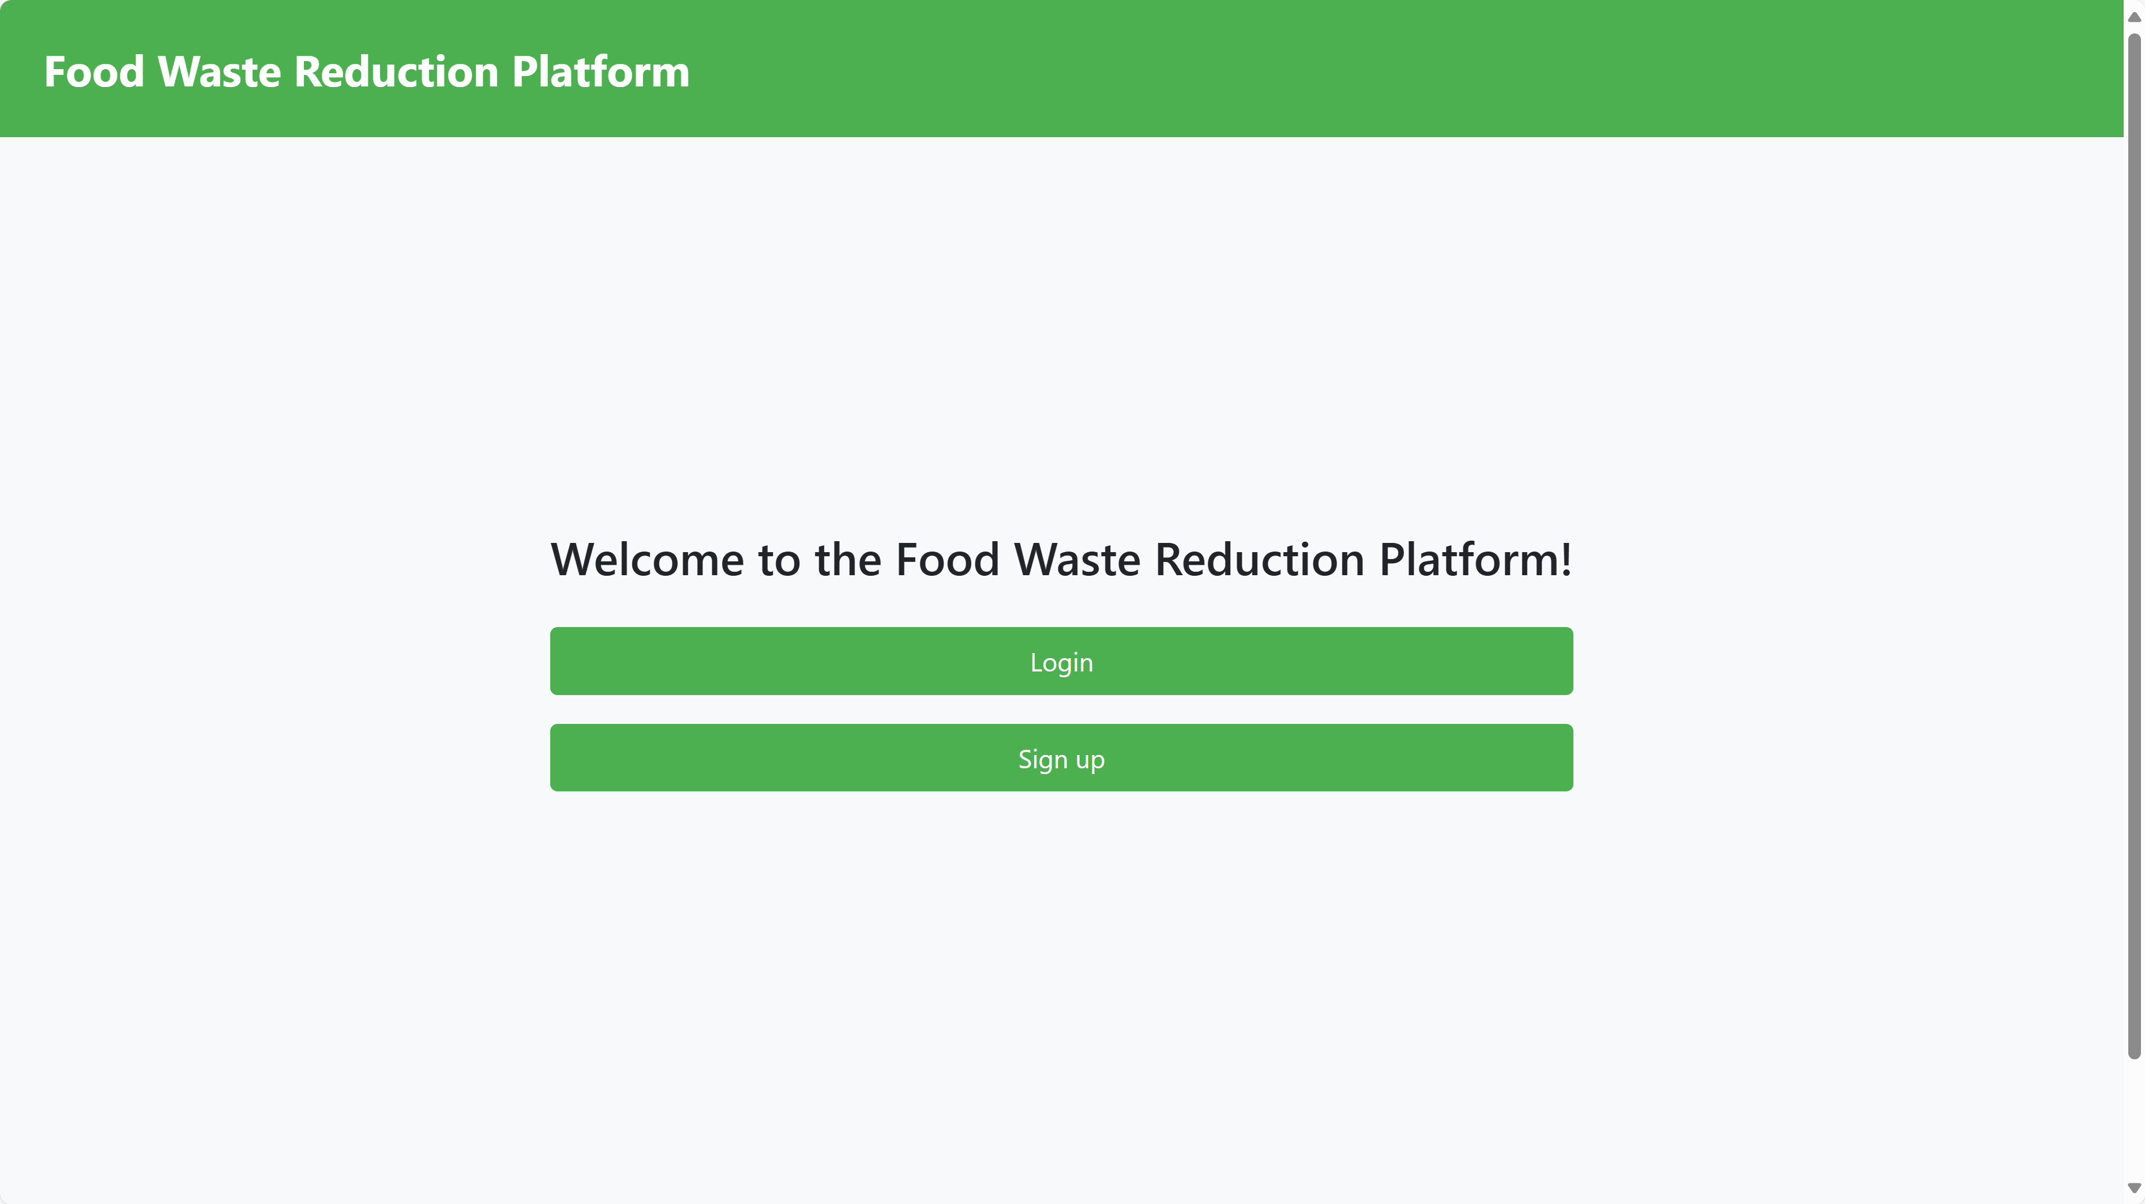
Food Waste Reduction Platform
Group 8 Members:
Yuan Lishu
Zu Haoran
Ye Yanni
Tang Yuan
Final Project - CST-8288
Lab Section: 033

Slide 2
Introduction
About the System:
The Food Waste Reduction Platform (FWRP) addresses food waste by redistributing surplus food.
It connects retailers, consumers, and charitable organizations to promote sustainability and reduce hunger.
Document Overview:
A comprehensive guide to the design and implementation of FWRP, including solution architecture, technologies, UML diagrams, database models, and deployment models.

Slide 3
Teamwork
Yanni Ye: Overall code implementation; high-level document writing
Haoran Zu: Front-end design, code integration, project management
Lishu Yuan: Database design, front-end design, implementation of subscription and alert features, assisted with code implementation
Yuan Tang: High-level UML diagram design, assisted with food item-related code implementation, wrote Javadoc
Collaboration Method:
Met four times a week. Progressed the project through various methods such as task division, modular writing, and relay writing. Used GitHub for code uploading and merging.

Slide 4
Solution
How did you put everything together for your project?
Task division, GitHub uploading, merging, and debugging together; this process is repeated in cycles.
Use of any external libraries? Certainly!
Commons-dbutils-1.8.1.jar
Druid-1.1.12.jar
Servlet-api.jar
Mysql-connector-j-8.3.0.jar
Design pattern:
Singleton pattern, Data Access Object (DAO), Observer

Slide 5
Solution
4 Junit and Code coverage:
JUnit Testing:
Purpose:
Ensures the functionality of individual components by isolating and testing each unit of code.
Focus Areas:
Core functionalities like user registration, inventory management, and alert systems.
Testing edge cases and error handling to ensure robustness.
Test Cases: Developed comprehensive test cases to cover all critical features and functionalities.

Slide 6
Version Control System
Utilize GitHub:
GitHub repo link: https://github.com/LishuYuan0512/JavaProject
Different functionalities of GitHub & Branching Strategy:
Each team member created a separate branch in their IDE to push their own code and write comments to commit(clarify the process).
Create a new branch to merge the code, team members cloned the combined code to continue working on their parts and pushed the updates to GitHub.
Use old branch to check the version history and debug previous issues.
Any critical issues were addressed with hotfix branches to quickly resolve problems in the production environment.

Slide 7
Challenges
Tests do not pass.
Solution：
Add jar to provide simulated environment instead of connecting to database .
Using different IDEs led to code compatibility issues.
Solution：
The team leader unified the code on the NetBeans platform.
Conflicts occurred when uploading code to GitHub.
Solution：
These were resolved by reviewing GitHub's history.

Slide 8
Demo
Functionalities to Demonstrate:
Implement functions through registration and login of different users, such as listing, modifying, and marking items by retailers, claiming items by charitable organizations, and purchasing and subscribing by consumers.
Bonus Functionalities:
Implement a security check through user filtering.
Limitation for user input data.

Slide 9
Future Enhancements
Our validation process can be more rigorous.
For example, the same email should not be allowed to register with different identities.
We can add a log file feature to help administrators debug the code more easily.
Additionally, we can introduce more donor users who can donate food to the system.

Slide 10

THANK YOU
Group 8 Members:
Yuan Lishu
Zu Haoran
Ye Yanni
Tang Yuan
Final Project - CST-8288
Lab Section: 033

